Slide 1
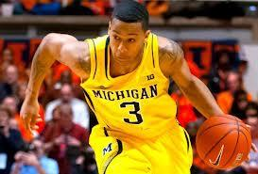
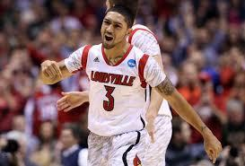
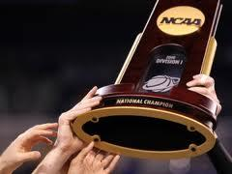

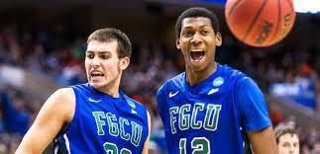
Busting the Bracket(or at least trying)
Ryan Burns
Aaron Adams

Slide 2
Outline
Background Knowledge
Fitted Formulas from the Past
2013 Predictions
2013 Results
Tangent Topics

Slide 3
Method Behind the Madness
Normalize all statistics (z scores)
Apply a formula of linear weights to create a composite z score
Compare these composite z scores to past and future brackets

Slide 4
Data Collection
Import ESPN data for all 347 D1 schools
Normalize based on tourney teams or all teams???
Gathered data for 2010-2013
Omitted Stats such as PPG

Slide 5
Basketball 101
FG% - Percentage of shots that are made.
3P% - Percentage of shots that are made from further away.
RPG - Grabbing the ball after a missed shot.
ORPG - Grabbing the ball after a missed shot from your team.
FTMPG - Percentage of shots made that are given for being fouled.
APG - Passes that result immediately in scored baskets.
TOPG - Giving the ball to the other team while on offense.
STPG - Taking the ball from the other team.
BLKPG - Literally blocking the opponent’s shot.

Slide 6
Tournament 101
Current format since 1985
Field of 64 Teams
Recently, “play in” games to expand to 68
4 sets of seeding from 1 to 16
31 automatic conference winning bids
37 (now) at large bids (others)

Slide 7
Scoring Guidelines
Unweighted or Weighted???
Powers of 2 Escalating per Round (1,2,4,8,16,32)
No Points for “play in” games on ESPN
8.15 million brackets completed in 2013 on ESPN.com

Slide 8
Some of Our Own Stats
Conference Factor (CF)
2 Points to ACC, Big 10, Big 12, Big East, SEC, CAA
1.5 Points to A10, -.5 Points to Mountain West
Conference Tourney Winners (CT)
Half of the positive points of the conf. factor
Top 20 NBA Draft Picks (T20)
1 Point for each, best estimate at the time for future year extrapolation

Slide 9
2010 Spreadsheet
Magical Trip to Excel

Slide 10
Final 2010 Formula
FG% + 1.5*FTMPG + 4*TOPG + RPG + ORPG + CF + T20 + 4*CT
Score/Percentile: 118/192
Notes: Butler stole 30 points alone, only 2 of the Final 4 (also Mich. St.)

Slide 11
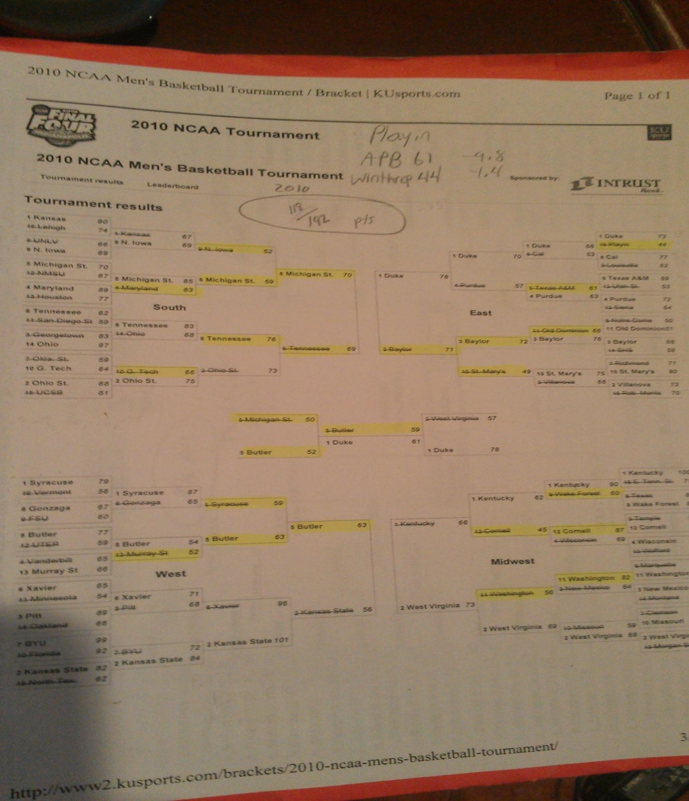
2010 Bracket

Slide 12
2011 Spreadsheet
Magical Trip to Excel

Slide 13
Final 2011 Formula
FG% + 0*3P% + 5*ORPG + 2*RPG + FTMPG + 0*APG + 6*TOPG + STPG + BLKPG + CF + 3*T20 + 10*CT
Score/Percentile: 127/192
Notes: Upsets Everywhere, More of the common games correct, Butler again (this time with 31 points off), Only 2 of the Final 4 (VCU #11)

Slide 14
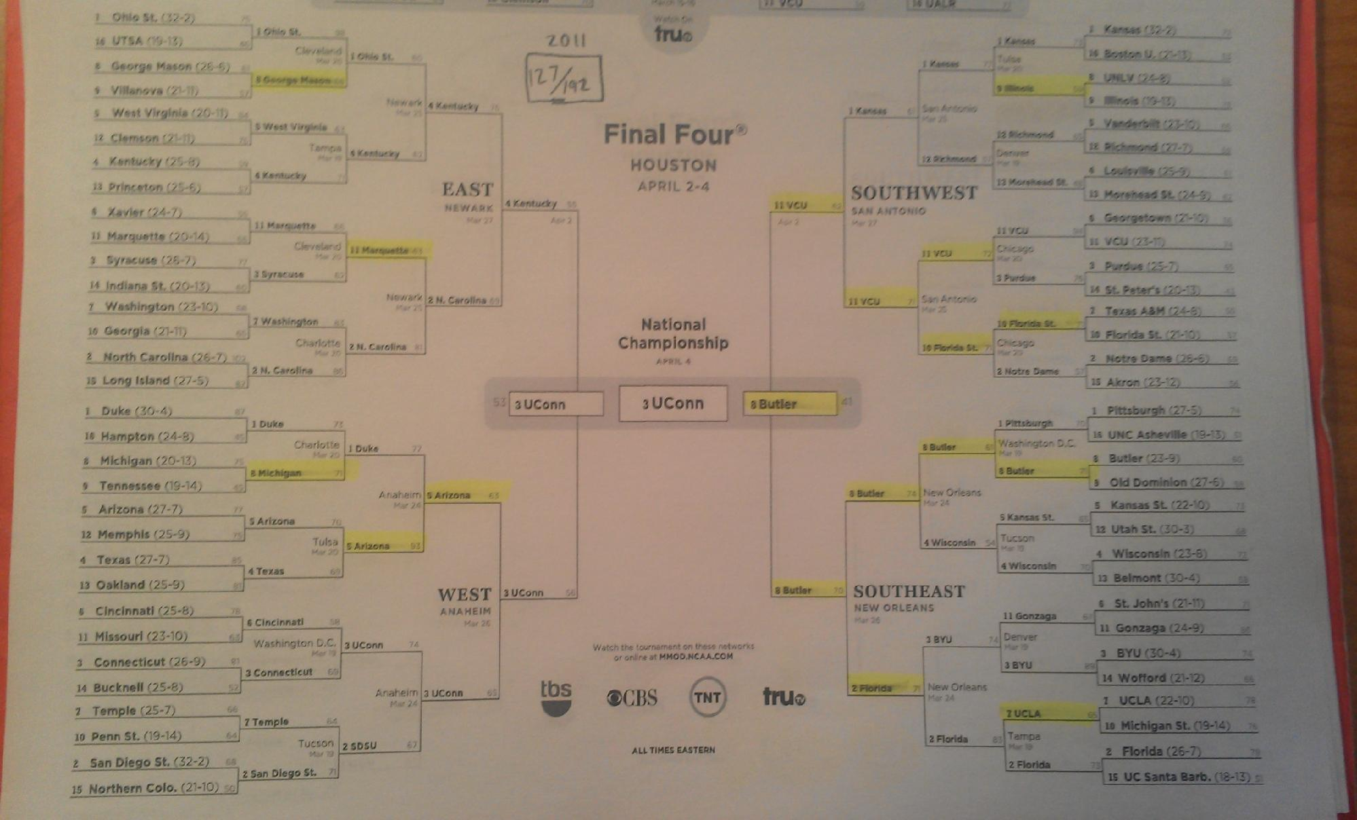
2011 Bracket

Slide 15
2012 Spreadsheet
Magical Trip to Excel

Slide 16
Final 2012 Formula
4.25*FG% + FTMPG + 2*RPG + ORPG + 2*BLKPG + 3*CF
Score/Percentile: 142/192
Notes: 2 of the Final Four, lots of small missed games, best overall points b/c of big games

Slide 17
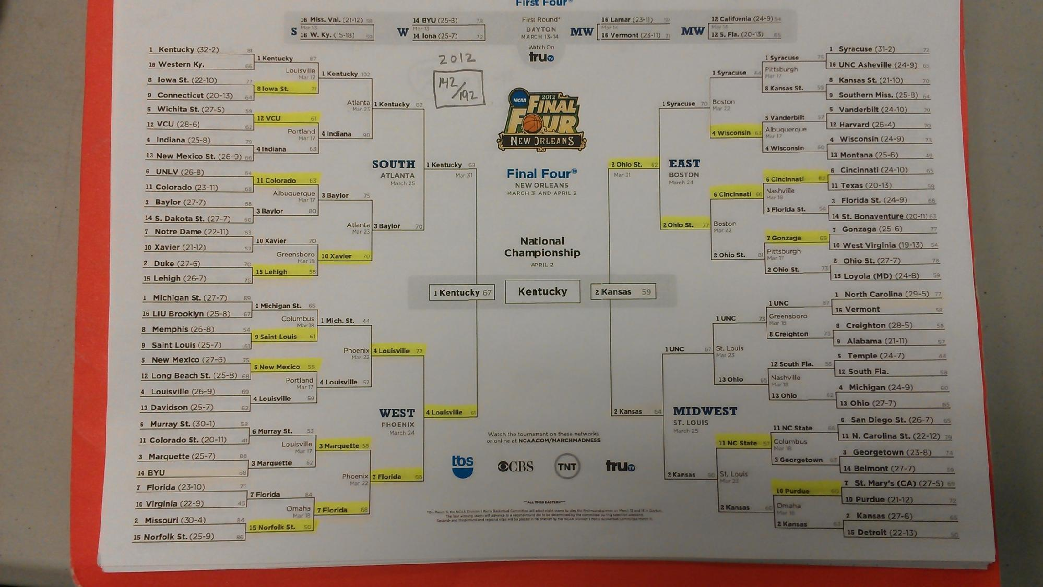
2012 Bracket

Slide 18
Combinations for 2013
Averaged - 25/12*FG% + 7/6*FTMPG + 10/3*TOPG + 5/3*RPG + 7/3*ORPG + 1/3*STPG + 2/3*BLKPG + 5/3*CF + 4/3*T20 + 14/3*CT
Regression - 16/3*FG% + 2/3*FTMPG - 2/3*TOPG + 8/3*RPG + 7/3*ORPG + 1/3*STPG + 8/3*BLKPG + 11/3*CF + 1/3*T20 + 2/3*CT
Little of Everything - FG% + 3P% + FTMPG + TOPG + RPG + ORPG + APG + STPG + BLKPG + CF + T20 + CT

Slide 19
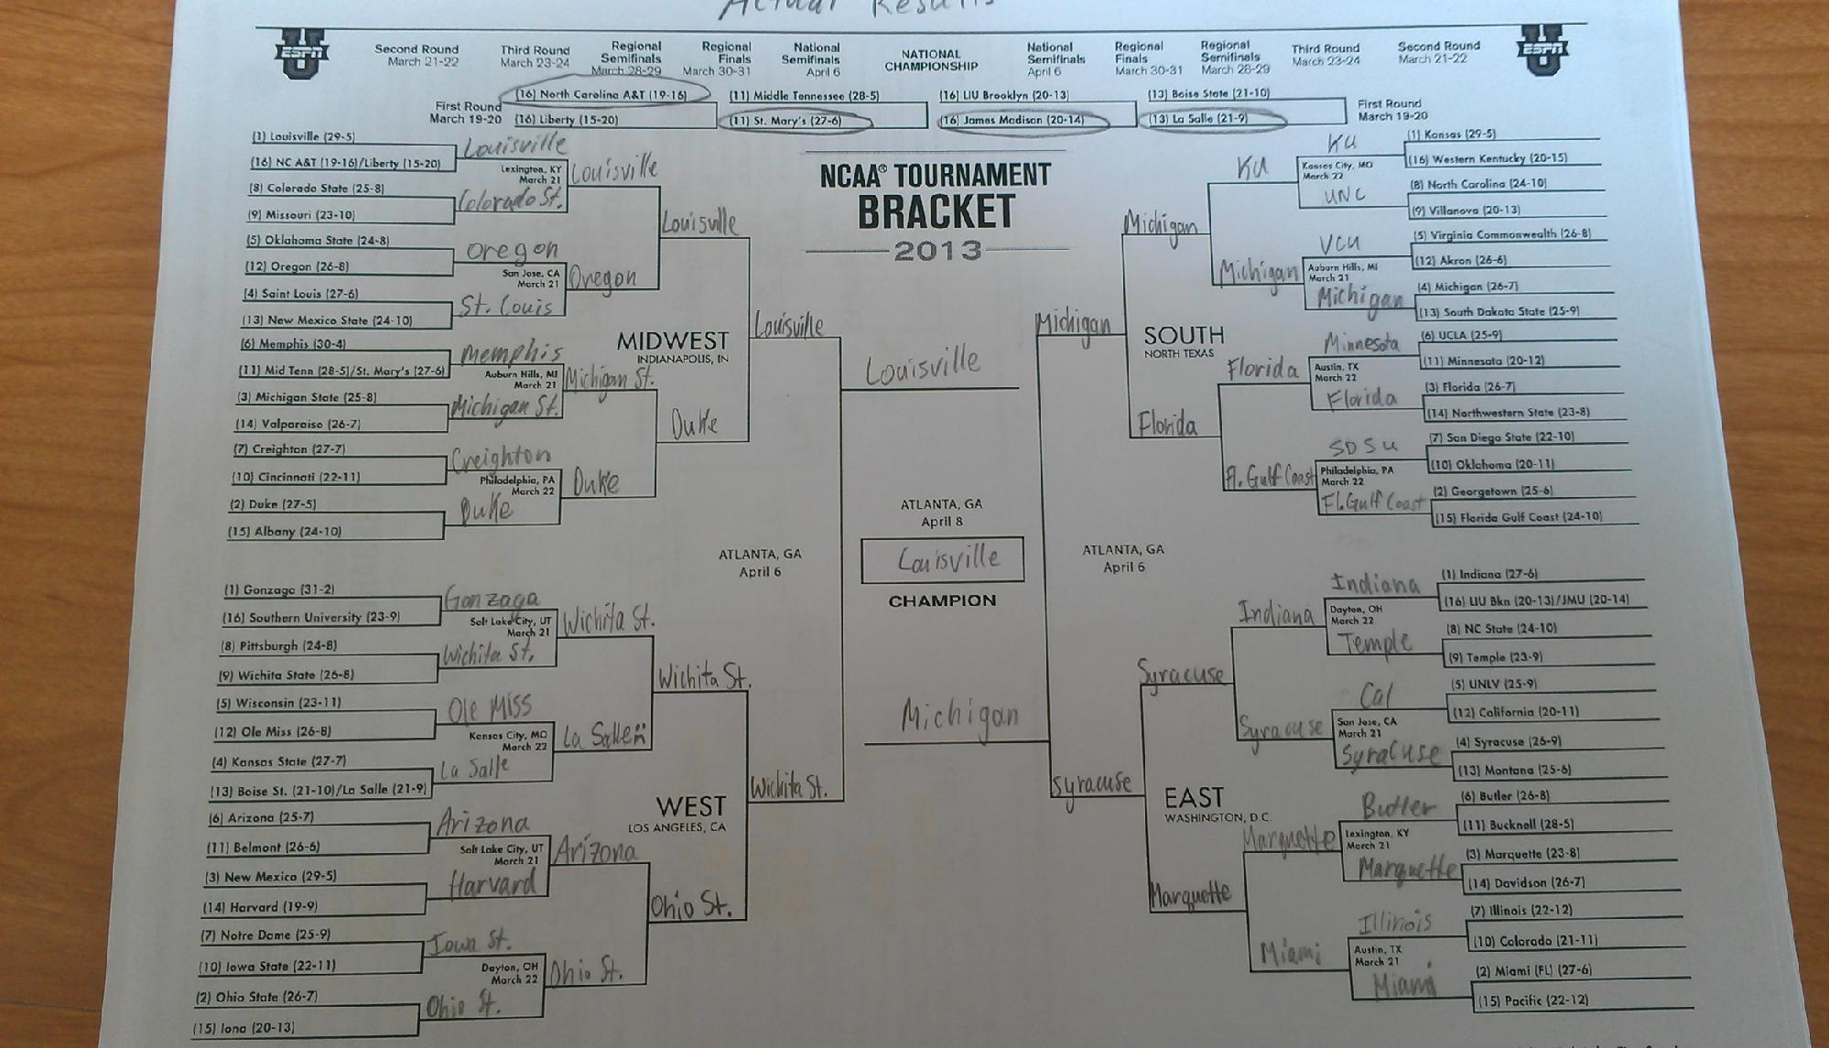
Actual 2013 Results

Slide 20
Regression Results
Final Four: Kansas, Missouri, Indiana, Pittsburgh
Score/Percentile: 39/192, 4.5 percentile
Notes: Correctly picked Fla Gulf Coast(15) winning two games, picked too many low seeds to go far, only got 1 Elite Eight team

Slide 21
2012 Results
Final Four: Kansas, Missouri, Ole Miss, Indiana
Score/Percentile: 40/192, 5.3 percentile
Notes: Picked Missouri(9), Picked only 1 Elite 8 team, Favoured offensive teams but this year was a defensive year

Slide 22
Averaged Results
Final Four: Ole Miss, Indiana, Louisville, Kansas
Score/Percentile: 59/192, 40.8 percentile
Notes: Only had 1 Final Four and 3 Elite Eight, Ole Miss lost in the second round

Slide 23
Little of Everything Results
Final Four: Indiana, Louisville, Ole Miss, Kansas
Score/Percentile: 61/192, 44.7 percentile
Notes: Favored offense too much, Had Michigan losing in second round

Slide 24
2010 Results
Final Four: Ole Miss, Michigan, Indiana, Colorado State
Score/Percentile: 69/192, 56th Percentile
Notes: Ole Miss and Colorado St. not making final four killed bracket, otherwise not that bad

Slide 25
2011 Results
Final Four: Ole Miss, Syracuse, Louisville, Michigan
Score/Percentile: 75/192, 63rd Percentile
Notes: Good other than no championship game picks, got 3/4 of final four

Slide 26
Holistic Results
Ryan
Final Four: Ohio State, Syracuse, Louisville, Kansas
Score/Percentile: 75/192, 63rd percentile
Notes: Had OSU winning but they didn't even make the Final Four
Aaron
Final Four: Kansas, Louisville, Syracuse, Ohio State
Score/Percentile: 93/192, 76.9 percentile
Notes: Had Pitt and Georgetown winning 3 games each, but both lost in first round, Kansas killed it

Slide 27
“Final” Results
Ryan
Final Four: Louisville, Syracuse, Michigan, Gonzaga
Score/Percentile: 133/192, 99.4 percentile
Notes: Best bracket (99.9 with 2 games left)
Aaron
Final Four: Kansas, Ohio State, Louisville, Miami
Score/Percentile: 69/192, 56th Percentile
Notes: Decent, didn't have either championship game team

Slide 28
2013 Nuances
Harvard(14) beat a 3 seed
Florida Gulf Coast became the first ever 15 seed to make the Sweet 16
Wichita St.(9) made the Final 4
The Big East outperformed the Big 10, despite the perceived strength difference in the regular season

Slide 29
Sources of Error
Had to pay ESPN for full list of stats (didn't have any defensive stats)
We were not able to utilize a computer program to maximize formulas (were working with discrete instead of continuous data)

Slide 30
More Complete Data - 2012
3 of the Final Four are top ranked defensive teams so more complete data would have favored them
More complete data gave a bracket with 149/192 points (7 Points Higher)
Other metrics such as RPI, BPI, and Ken Pom stats make the data much more comprehensive

Slide 31
The Dynamics of an Upset
3 of the upsets (Colorado beating UNLV, South Florida beating Temple, and San Diego State beating Temple) can be explained by conference factor and overseeding midmajors
Magical trip to excel

Slide 32
General Oddities
No 3P% or APG in any formula
Negative TOPG coefficient in the Regression Formula (more turnovers increased score?)
Certain mid-major schools being immune to their potentially inferior competition (Butler)
Conference Realignment complicates matters (VCU, Butler, etc.)

Slide 33
Georgia Tech’s Guess
Method - Logistic Regression/Markov Chain
Final Four: Florida, Gonzaga, Louisville, Indiana
Score/Percentile: 68/192, ~55th Percentile
Notes: Not bad, but having neither championship game team correct hurt. Lower than past years for them (had picked the champion 3 of the previous 5 years)

Slide 34



The Good, The Bad, and the Ugly
99.4%

